Slide 1

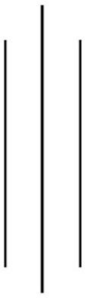
Tribhuvan University
Bhaktapur Multiple Campus
Dudhpati-1 Bhaktapur, Nepal
"Lab Report 2: Numerical Methods"(CSC212)
Semester: III
Name: Mark Dangal
Roll No: 26
Level: B.Sc. CSIT
Submitted to: Surya Bam
Submission Date:
Signature of subject teacher

Slide 2
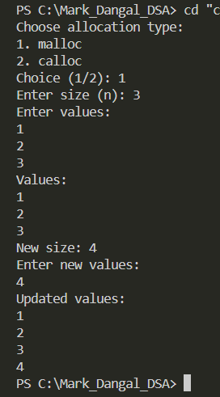
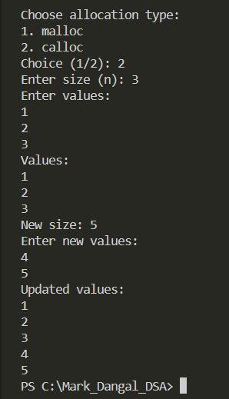
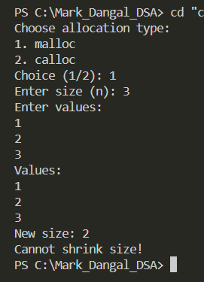
DMA Output
if (new_n > old_n)
also using malloc
if (new_n > old_n)
also using calloc
If(new_n<old_n

Slide 3
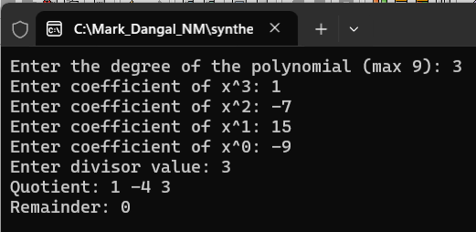
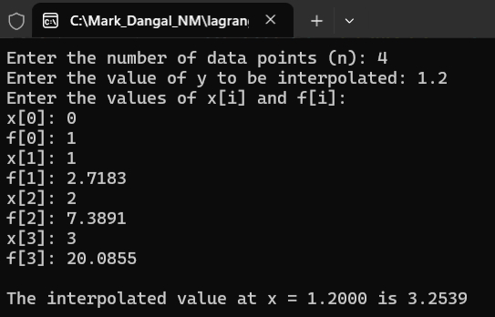
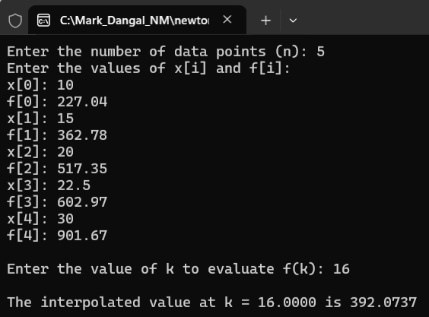
Synthetic division
Lagrange Interpolation(second order)
Newton Divided difference interpolation

Slide 4
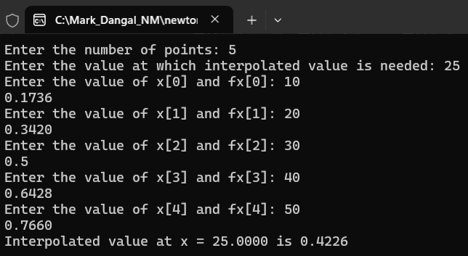

Newton Gregory's forward interpolation
Newton Gregory’s Backward interpolation

Slide 5
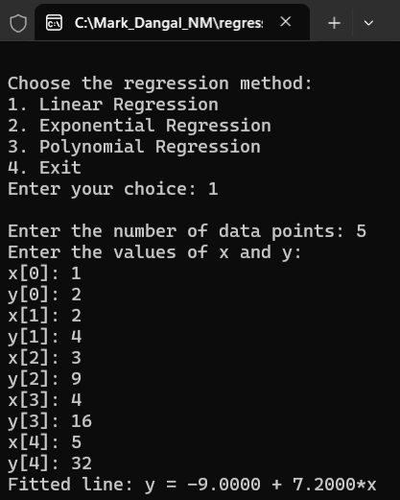
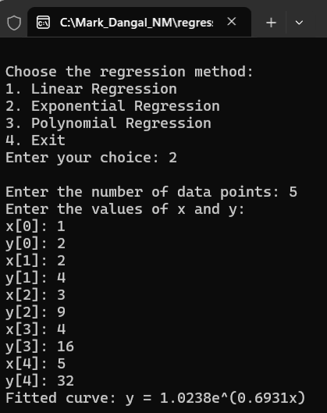
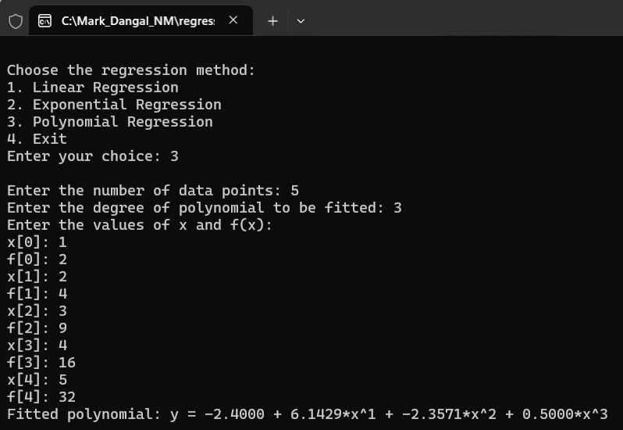
1.Linear regression
2. Exponential regression
3. Polynomial regression

